Slide 1
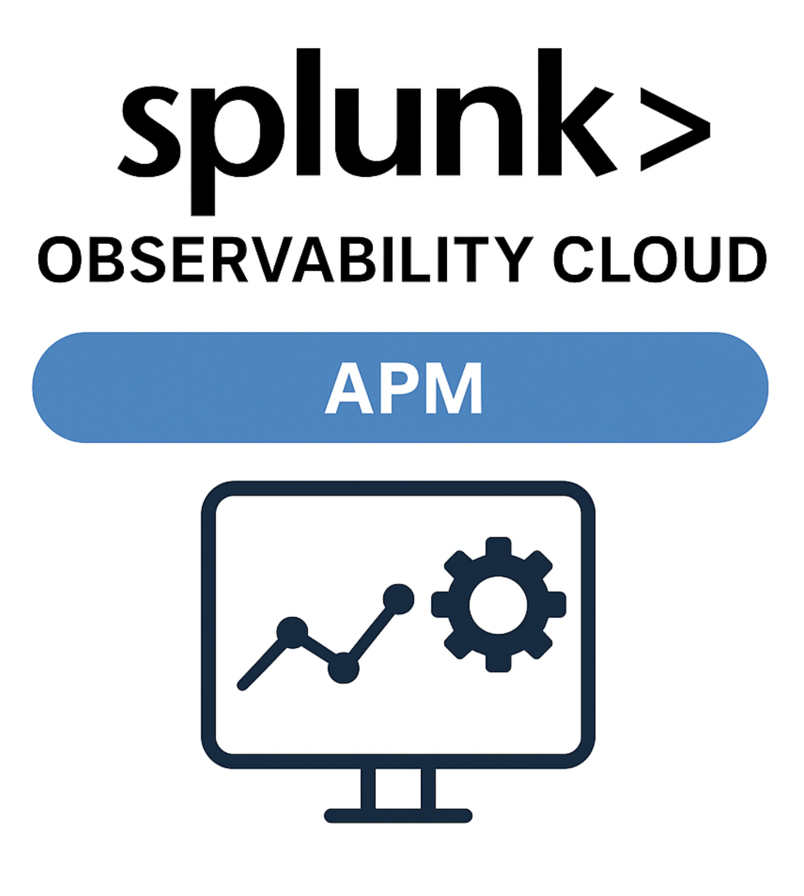
Splunk Observability Cloud

Slide 2
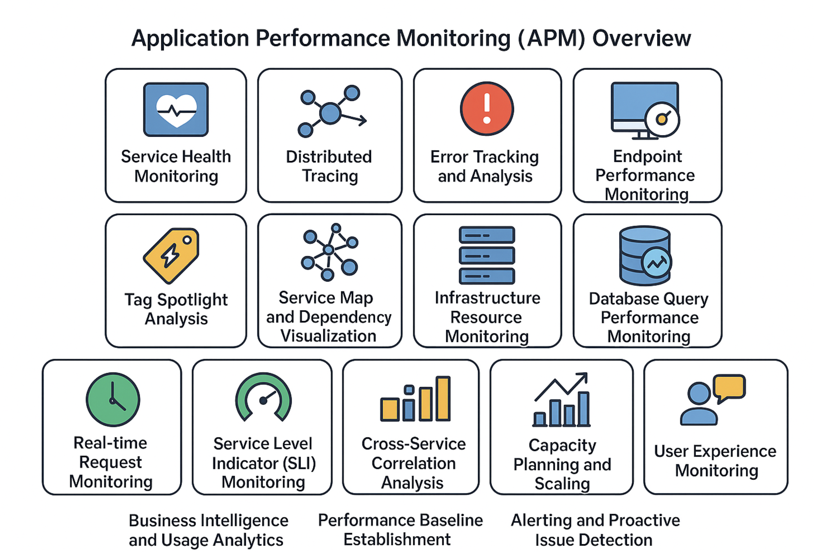
List of APM Use Cases
These are list of APM use cases which are providing end-to-end monitoring from user requests to database queries across the CXTM application stack.

Slide 3
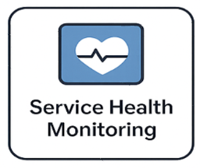
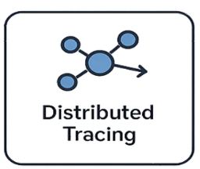
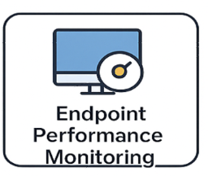
Use Cases
Monitors availability and performance of all CXTM services with instant visibility into system health across 8 instrumented services.
Follows user requests across all microservices from initial click through database queries with complete visibility.
Tracks response times for each application feature - dashboard and automation endpoints serve 458 users each.
Identifies service degradation before customer impact with automated alerting and 100% success rate tracking.
Pinpoints slow components in request chains - database <1ms, cache 3ms, application logic optimization needed.
Monitors P50/P90/P99 latencies ensuring 99% of users get <210ms response times with zero errors.
Tracks CPU, memory, and infrastructure usage - currently showing 5% utilization with 10x growth capacity available.
Maps service interactions and communication patterns across cxtm-web, scheduler, webcron, and all connected services.
Identifies most valuable endpoints based on traffic volume - 15.3k GET operations vs 8 POST operations showing read-heavy usage.

Slide 4
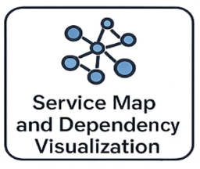
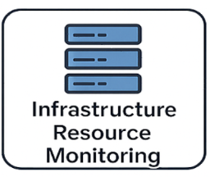
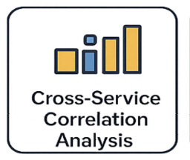
Use Cases
Visual representation of CXTM applications showing cxtm-web connecting to redis (3ms) and mysql (917μs) with all service dependencies
Comprehensive monitoring of CPU (5% usage), memory (10% peak), disk, and network across all infrastructure components.
Analyzes relationships between services - cxtm-web (160ms) vs microservices (3-7ms) identifying optimization priorities.
Live performance metrics displayed on architecture diagram - identifies bottlenecks and validates design decisions across 8 connected
services.
Current resource utilization shows 10x growth capacity available with significant cost optimization opportunities (50% savings potential).
Monitors how performance issues in one service affect others - prevents cascade failures across the CXTM ecosystem.
Links infrastructure metrics to application performance - validates that database/cache performance is not infrastructure-limited.
Correlates service interactions with business workflows - dashboard and automation features drive most cross-service communication.
Understanding downstream effects of changes and single points of failure with clear visualization of service communication patterns.

Slide 5
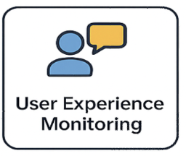
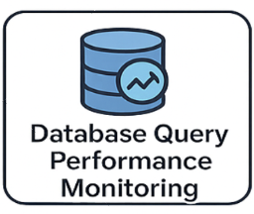
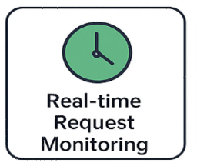
Use Cases
Tracks application performance from the user's perspective, measuring actual user interactions, response times, and feature usage patterns
across the entire CXTM application
Monitors individual SQL queries, execution times, and database performance with detailed analysis of query patterns, optimization
opportunities, and resource utilization
Provides live monitoring of user requests flowing through the system, showing real-time traffic patterns, response times, and system load
as requests are processed.

